Slide 1


SHRIDEVI HACKATHON 2024
Lung Cancer Detection Using CNN
Theme- Medical
Team Members Name- Vishwasneha C V, Tejaswini H G, Harshitha K, Apeksha H P
College Name- Kalpataru Institute of Technology, Tiptur 572201
SHRIDEVI NATIONAL LEVEL HACKATHON - 2024

Slide 2
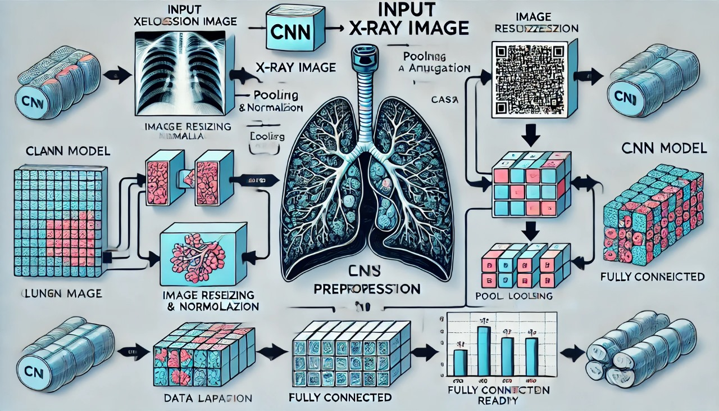
SHRIDEVI NATIONAL LEVEL HACKATHON - 2024

Slide 3
SwāsaRakshaka
M72
Proposed Solution :
Lung cancer detection using CNN.
We take X-ray Image as input and our model detect Lung Cancer.
And gives result as Positive(1) or Negative(0).
And we have trained our model by giving 3000+ images as Train and Test data, To increase the accuracy.
Our model will posses great accuracy level between 85 to 95%
SHRIDEVI NATIONAL LEVEL HACKATHON - 2024

Slide 4
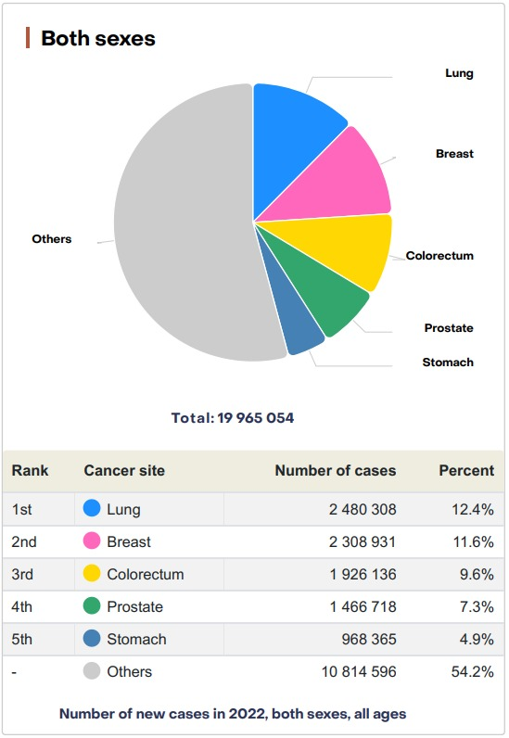
SHRIDEVI NATIONAL LEVEL HACKATHON - 2024

Slide 5
TECHNICAL APPROACH
M72
Technologies to be used : Python, TensorFlow for model development.
Flask, Keras(RESTful API) for final result displaying.
Machine Learning ,scikit learn
SHRIDEVI NATIONAL LEVEL HACKATHON - 2024

Slide 6
FEATURES
M72
Edge and Contour Detection
Texture Patterns
Opacity and Density
Reduced False Positives with Layered Processing
SHRIDEVI NATIONAL LEVEL HACKATHON - 2024

Slide 7
CHALLENGES FACED
M72
A major challenge we faced was to upload a folder full of images
to overcome this we have used CNN to train the images efficiently

